Slide 1
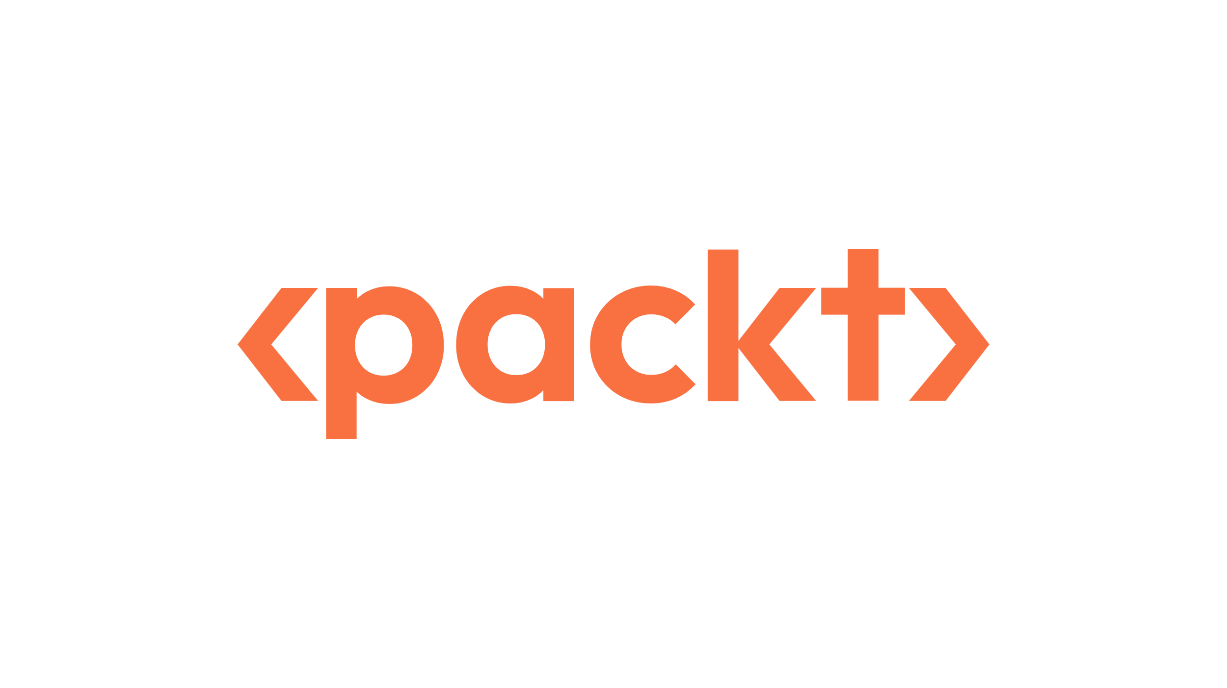


Starting Now
AI Agents in Finance
Agentic Workflows
Reasoning Patterns
Architectures
Frameworks
Practical Use Cases in Finance
Hanane DUPOUY
Algorithmic Trader
Equity - Execution

Slide 2

AI Agents in Finance
From Agentic Workflows to Practical Use Cases in Finance

Slide 3

About Hanane DUPOUY
I work as a Director - Quantitative Algorithmic Trader in the Equity Departement of a french bank.
I was also a data scientist and managing a team of data science and business intelligence.
I’ve been working in the finance industry for more than 16 years.
I wrote three white papers about the application of Generative AI in finance (LinkedIn profile - “About” session to have links to the papers) .
I’m currently co-authoring a book about “AI AGENTS IN FINANCE” with Packt.
Visit my github repo to have the latest applications of Gen AI in finance:
https://github.com/hananedupouy/LLMs-in-Finance
Hanane DUPOUY
Algorithmic Trader
Equity - Execution

Slide 4
Agenda
01
LLMs Limitation and solutions
02
What are AI Agents?
03
Agentic Systems Description - Industry
04
Design Pattern
05
Reasoning Paradigms
06
Architectural Styles
07
Frameworks
08
Practical Examples in Finance
09
Key Takeaways

Slide 5
Section [01]: LLMs Limitation and Solutions

Slide 6
LLMs Limitation and solutions
LLMs Limitations
Cutoff knowledge: No Real-Time and Dynamic information Handling
GPT-4o
Claude 3.5 Sonnet
Claude 3.7 Sonnet
Who was elected president of the USA in 2025?
Training data Up to June 2024
April 1, 2024
October 2024
As of my last update, I don't have access to the official results of the 2024 U.S. presidential election, so I can't confirm who the elected president of the United States is in 2025.
For the most accurate and up-to-date information, I recommend checking reliable news sources or official government announcements.
GPT-4o
Llama 3
Llama 4
December 2023
August 2024
Examples - Source for Llama models: https://github.com/meta-llama/llama-models/blob/main/models/llama4/MODEL_CARD.md
>
Pg: 6

Slide 7
LLMs Limitation and solutions
LLMs Limitations
Cutoff knowledge: No Real-Time and Dynamic information Handling
GPT-4o
Claude 3.5 Sonnet
Claude 3.7 Sonnet
Who was elected president of the USA in 2025?
Training data Up to June 2024
April 1, 2024
October 2024
As of my last update, I don't have access to the official results of the 2024 U.S. presidential election, so I can't confirm who the elected president of the United States is in 2025.
For the most accurate and up-to-date information, I recommend checking reliable news sources or official government announcements.
GPT-4o
Llama 3
Llama 4
December 2023
August 2024
Search Web
Examples - Source for Llama models: https://github.com/meta-llama/llama-models/blob/main/models/llama4/MODEL_CARD.md
>
Pg: 7

Slide 8
LLMs Limitation and solutions
LLMs Limitations
Cutoff knowledge
Domain Specific: Finance, Medecine, Law
>
Pg: 8

Slide 9
LLMs Limitation and solutions
LLMs Limitations
Cutoff knowledge
Domain Specific: Finance, Medecine, Law
Proprietary Data : A firm internal data
>
Pg: 9

Slide 10
LLMs Limitation and solutions
LLMs Limitations
Cutoff knowledge
Domain Specific: Finance, Medecine, Law
Proprietary Data : A firm internal data
Hallucination
Refers to the phenomenon where the model generates information that is incorrect, misleading, or completely fabricated, despite sounding plausible.
>
Pg: 10

Slide 11
LLMs Limitation and solutions
Solutions
Solutions
Cutoff knowledge
Domain Specific: Finance, Medecine, Law
Proprietary Data : A firm internal data
Fine-Tuning
Instruction - Prompting:
(Ex. Few-shot learning)
RAG (Retrieval Augmented Generation)
AI AGENTS
>
Pg: 11

Slide 12
POLL TIME!

Slide 13
POLL TIME
Poll 1: Have you used the AI agent?
Yes
No
Want to but don’t know how
>
Pg: 13

Slide 14
Section [02]: What are AI Agents?

Slide 15
What are AI Agents?
Definition
An AI Agent is a system that autonomously performs tasks, makes decisions, or interacts with its environment based on data, logic, or learned patterns, in order to achieve specific goals.
Key Characteristics of an agentic workflow:
Autonomy
Interactivity
Adaptability
Goal-Oriented
Rationale Behind of an agentic workflow:
Efficiency and Productivity
Scalability
Complex Problem Solving
Consistency and Reliability
Cost Reduction
Flexibility
In finance:
AI agents are used to analyze market trends, detect fraud, optimize portfolios, and assist with regulatory compliance.
>
Pg: 15

Slide 16

What are AI Agents?
Non-Agentic vs Agentic Workflow
Prompt
A single-step process where an AI system provides a direct response to a query.
To refine this answer, the user needs to write another question.
Output
Example:
A chatbot answering a customer's question about their account balance.
>
Pg: 16

Slide 17
What are AI Agents?
Non-Agentic vs Agentic Workflow
External Systems
Tools:
API Calls
Code execution
Search the web
Prompt
Prompt
A single-step process where an AI system provides a direct response to a query.
To refine this answer, the user needs to write another question.
A multi-step process where an AI system iterates and improves its output.
It incorporates autonomous agents to execute tasks, make decisions, and interact with systems or other agents without continuous human guidance.
Output
Output
Other Agents
Example:
An AI system analyzing a company's financial statements, identifying potential areas for further investigation, conducting additional research, and producing a comprehensive investment recommendation.
Example:
A chatbot answering a customer's question about their account balance.
>
Pg: 17

Slide 18
Section [03]: Agentic Systems Description - Industry

Slide 19
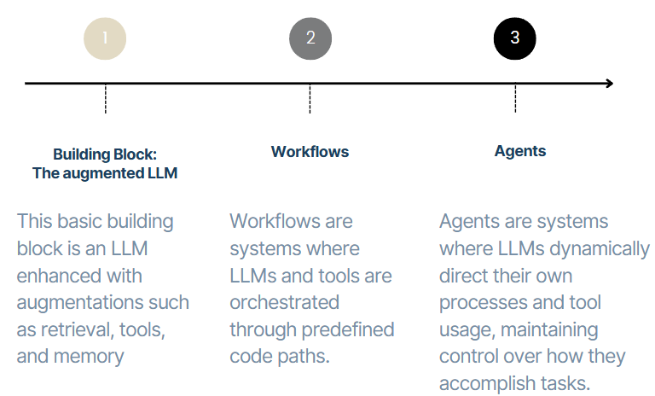
Agentic Systems Description - Industry
When to Use Agents - and When not to?
Start with the simplest solution possible - This could be:
Optimizing single LLM calls with retrieval and in-context learning
Not using any agentic system
Only increasing complexity when needed.
Avoid building agentic systems unless their tradeoff of higher latency and cost for better task performance is justified.
Use workflows for predictable and consistent execution of well-defined tasks.
Choose agents when flexibility and model-driven decision-making at scale are required.
Increasing Complexity
Source: Anthropic - Building Effective Agents
>
Pg: 19

Slide 20
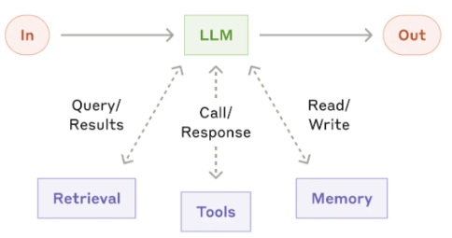
Agentic Systems Description - Industry
Examples of Agentic Workflows
1- BUILDING BLOCK:The augmented LLM
Where an LLM is augmented by various features such as Retrieval, Tools and Memory.
Source: Anthropic - Building Effective Agents
>
Pg: 20

Slide 21
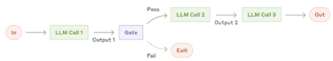
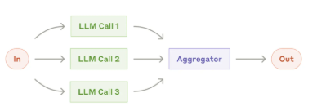
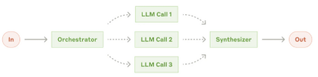
Agentic Systems Description - Industry
Examples of Agentic Workflows
2- WORKFLOW
Prompt Chaining
Parallelization
Prompt chaining breaks a task into a sequence of steps.
Each LLM call processes the output of the previous step.
Programmatic checks can be added to intermediate steps for validation.
Use "gates" to ensure the process remains on track.
This approach helps maintain accuracy and control in multi-step workflows.
LLMs can perform tasks simultaneously, with outputs aggregated programmatically.
There are 2 key variations in parallelization:
1- Sectioning: Splits a task into independent subtasks that are executed in parallel.
2- Voting: Executes the same task multiple times to generate diverse outputs.
Orchestrator-Workers
The orchestrator-workers workflow uses a central LLM to manage tasks dynamically.
The central LLM breaks down tasks into smaller components.
These components are delegated to worker LLMs for execution.
The central LLM synthesizes the results from the worker LLMs.
Source: Anthropic - Building Effective Agents
>
Pg: 21

Slide 22
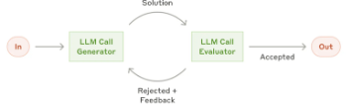
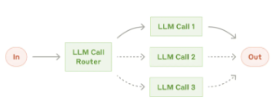
Agentic Systems Description - Industry
Examples of Agentic Workflows
2- WORKFLOW
Routing
Evaluator-optimizer
Routing identifies an input type and assigns it to a specific follow-up task.
This approach ensures tasks are handled separately and efficiently.
It facilitates the development of prompts tailored to specific needs.
Without routing, optimizing for one input type can negatively impact performance on others.
This approach ensures tailored handling for different input types, improving overall performance.
One LLM call generates a response.
Another LLM evaluates the response and provides feedback.
This process operates in a continuous loop for iterative improvement.
Source: Anthropic - Building Effective Agents
>
Pg: 22

Slide 23
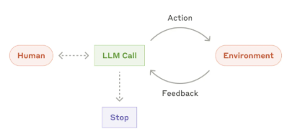


Agentic Systems Description - Industry
Examples of Agentic Workflows
3- AGENTS
Agents begin tasks with either a command or an interactive discussion with the user.
Once tasks are clear, agents operate independently, with the option to seek further user input when needed.
During execution, agents rely on “ground truth” (e.g., tool results or code execution) to evaluate progress.
Agents may pause for human feedback at checkpoints or when facing blockers, with tasks ending upon completion or when predefined stopping conditions are met.
While capable of handling complex tasks, agents are often implemented simply as LLMs using tools based on environmental feedback in a loop.
Clear and thoughtful design of toolsets and their documentation is essential for effective agent functionality.
Use agents for open-ended tasks with unpredictable steps or no fixed path.
Ideal for scaling tasks in trusted environments requiring autonomy.
Higher costs and error risks demand sandbox testing and guardrails.
Source: Anthropic - Building Effective Agents
>
Pg: 23

Slide 24
Section [04]: Design Pattern

Slide 25
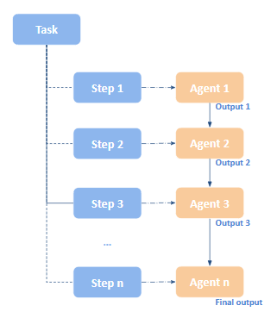
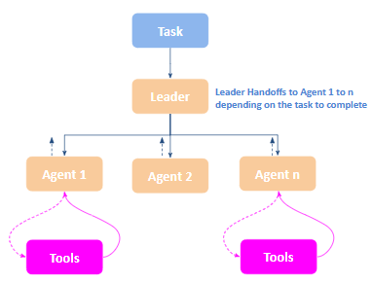
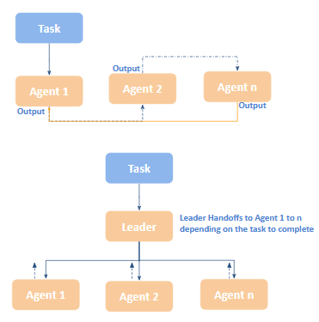
Design Pattern - Industry
Common Agentic Patterns - OpenAI
Deterministic Flows
Handoffs and routing
Agents as Tools
Breakdown a task into smaller steps.
Each task can be performed by an agent
The output of one agent is used as input to the next
The final agent provides the final answer
Specialized sub-agents handling specific tasks.
Use handoffs to route a given task to a specific agent (or more).
Use peer-to-peer handoffs (from one agent to another) or leader-follower handoffs (One agent is responsible of routing tasks to the adequate agents), or also hierarchical handoffs.
Specify tools the agent can use to achieve a given goal
Help access to a specific knowledge that is unknown by the LLM itself: API, database, website,...
Source: OpenAI
>
Pg: 25

Slide 26
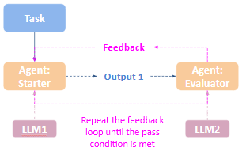
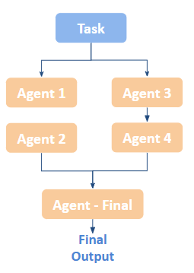
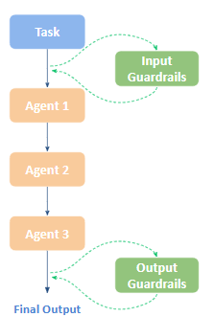
Design Pattern - Industry
Common Agentic Patterns - OpenAI
LLMs-as-a-Judge
Parallelization
Guardrails
Use an LLM to generate an answer.
Use another LLM to reflect on the generated answer.
You can use small model for the first one and large model for the feedback to optimize cost.
Repeat until get the best feedback
Running in parallel several agents that don’t depend on each other
Useful for :
Latency when tasks are independent (Speed up execution time + User responsiveness (chatbots)):
In a research assistant, one agent summarizes an article, another checks references, and another extracts key figures.
Executing the same tasks but with different LLMs to cross-check results and increase robustness of the AI app:
One agent uses GPT-4, another Claude 3, to verify output consistency.
Each agent may be responsible for analyzing a different data source or API—parallelizing avoids bottlenecks:
One agent queries Yahoo Finance, another calls a local database, another reads a PDF.
Running several agents with different strategies or hypothesis, than comparing results to choose to the best outcome (Exploration of Alternatives):
For portfolio optimization for example
Guardrails are used to make sure that the inputs to the agents or the outputs from the agents are VALID.
Agents might have access to sensitive client data or internal documents. A user query might unintentionally (or maliciously) try to access confidential information.
Source: OpenAI
>
Pg: 26

Slide 27
Design Pattern - Industry
Common Agentic Patterns - deeplearning.ai
Planning
Planning is the process by which an LLM:
Breaks down a high-level objective into a sequence of intermediate steps or subgoals, then
Determines the order and logic in which to execute them.
It enables the agent to act strategically, choosing when and how to use tools, delegate to other agents, or request additional input—ensuring that each step contributes to achieving the overall goal.
Multi-Agent Collaboration
Different AI Agents are working together to achieve a shared goal.
Each agent may specialize in a specific task.
Various architectures can be implemented to enable agents to break down tasks, exchange ideas, debate strategies, take actions, and refine answers-ultimately producing more effective solutions.
Task
Planning
Multi-Agent Collaboration
Agent
Tool Use
Tool Use
Reflection
The LLM is equipped with external tools—such as web search, code execution, API calls, or custom functions—that enable it to gather information, perform actions, or process data more effectively.
Tool use has become possible thanks to recent updates and fine-tuning of LLMs over the past year, enabling support for function calling.
The LLM can evaluate and refine its own response to improve quality and accuracy.
One approach is to use two LLMs—one generates the initial answer, and the second reflects on it and provides feedback.
You can then combine the original answer and the feedback to prompt the model again for a more polished, final response.
Reflection
Source: deeplearning.ai
>
Pg: 27

Slide 28
Section [05]: Reasoning Paradigms

Slide 29
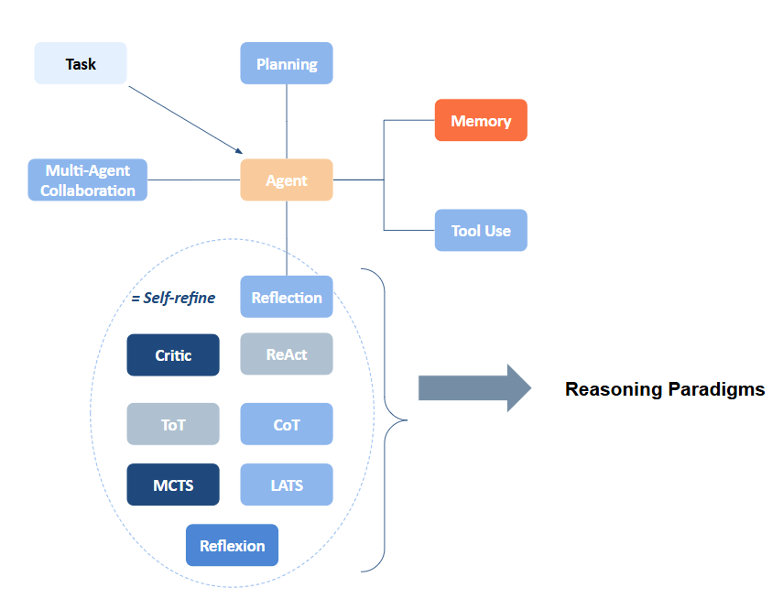
Reasoning Paradigms
Detailed Common Agentic Patterns
>
Pg: 29

Slide 30
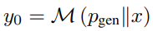
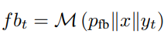
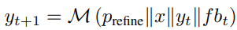
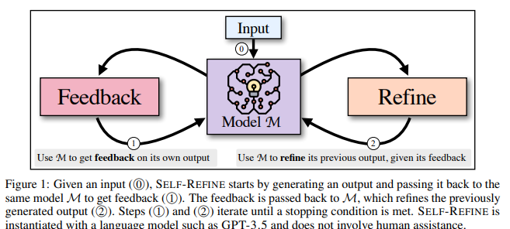
Reasoning Paradigms
Self-Refine
Self-Refine: Iterative Refinement with Self-Feedback
Goal: Improve the initial output from an LLM through iterative feedback and refinement.
This leads to generate high-quality outputs.
Self-Refine steps
The same LLM is the:
Input
Step 1: Generate an initial output using an LLM given a user’s query
Generator
initial generation
x: Input
p_{gen} Prompt with few-shot learning
M: Model (LLM)
y₀: output
Step 2 - feedback: Use the same LLM to provide a feedback on the generated output from the first step
x: Input
y_{t}: Output (either from the initial generation or from the refiner)
p_{fb} Prompt with few-shot learning for feedback
M: the same model than “generation”
fb_{t}: feedback
Iterate
Feedback provider
Feedback
Iterate
Step 3 - refinement: Use the same LLM to generate a refined answer by considering the initial output (step 1) and the feedback (step 2)
Iteration
Refiner
Refine
x: Input
y_{t}: Output (either from the initial generation or from the refiner)
fb_{t}: feedback
p_{refine} Prompt with few-shot learning for refinement
M: the same model than “generation” and “feedback”
y_{t+1}: Refined output
Iteration between feedback and refinement is done until a condition is met:
Number of max iterations is reached
No further feedback is needed
Source: SELF-REFINE: Iterative Refinement with Self-Feedback. https://arxiv.org/pdf/2303.17651
>
Pg: 30

Slide 31
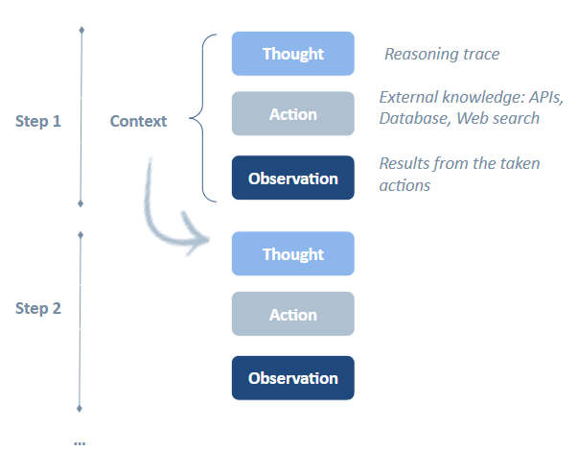
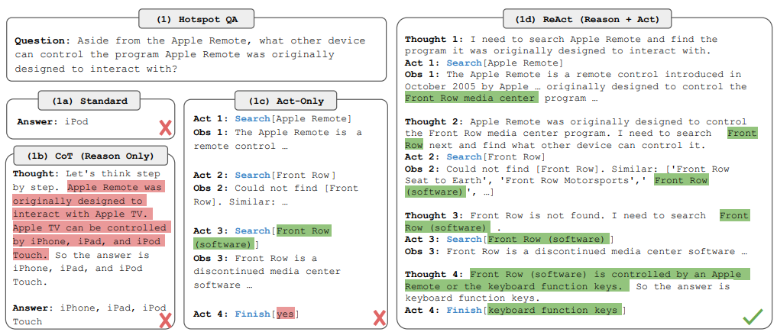
Reasoning Paradigms
ReAct
ReAct = Reasoning + Acting
Using LLMs to generate both :
1- Reasoning traces and
2- Task-specific actions
Both in an interleaved manner to create dynamic interaction between the two.
Reasoning traces—like internal thought processes—help the model plan, adjust action plans, and manage exceptions during execution.
Actions serve as a bridge to external systems, such as databases or environments, enabling the model to gather new information and refine its approach in real time.
Different types of thoughts:
1- Decompose questions (“I need to search x, find y, then find z”)
2- Extract information from Wikipedia observations (“x was started in 1844”, “The paragraph does not tell x”)
3- Perform commonsense reasoning (“x is not y, so z must instead be...”), arithmetic reasoning (“1844 < 1989”),
4- Guide search reformulation (“maybe I can search/look up x instead”)
5- Synthesize the final answer (“...so the answer is x”)
Source: REACT: SYNERGIZING REASONING AND ACTING IN LANGUAGE MODELS. https://arxiv.org/pdf/2210.03629
>
Pg: 31

Slide 32
Section [06]: Architectural Styles

Slide 33
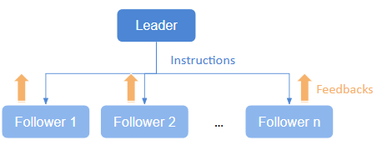
Architectural Styles in Agentic Workflows
Multi-Agent Collaboration
Various agents collaborate together to achieve a certain goal.
Leader-Follower: One agent acts as the leader and coordinates actions, while other agents follow instructions. The leader sends commands or instructions to followers, which execute the commands and may provide feedback.
Peer-to-Peer: Agents interact as equals, collaborating to achieve goals.
Hierarchical: Agents are organized in a hierarchy with defined roles.
Sequential
Parallelization
Leader-Follower
Leader Agent:
Coordinates and controls the overall operation.
Sends commands or instructions to follower agents.
Follower Agents:
Execute commands received from the leader.
Perform specific tasks as instructed; may send feedback or status updates back to the leader.
>
Pg: 33

Slide 34
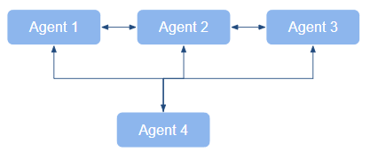
Architectural Styles in Agentic Workflows
Multi-Agent Collaboration
Various agents collaborate together to achieve a certain goal.
Leader-Follower: One agent acts as the leader and coordinates actions, while other agents follow instructions. The leader sends commands or instructions to followers, which execute the commands and may provide feedback.
Peer-to-Peer: Agents interact as equals, collaborating to achieve goals.
Hierarchical: Agents are organized in a hierarchy with defined roles.
Sequential
Parallelization
Leader-Follower
Peer-to-peer
Leader Agent:
Coordinates and controls the overall operation.
Sends commands or instructions to follower agents.
Follower Agents:
Execute commands received from the leader.
Perform specific tasks as instructed; may send feedback or status updates back to the leader.
Agents:
Agents 1, 2, 3 and 4 are peers with equal roles and responsibilities
Agents communicate directly with one another without any intermediary.
Communication can be bi-directional and occurs as needed.
Decisions are made collectively or individually without centralized control.
>
Pg: 34

Slide 35
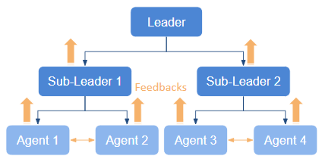
Architectural Styles in Agentic Workflows
Multi-Agent Collaboration
Various agents collaborate together to achieve a certain goal.
Leader-Follower: One agent acts as the leader and coordinates actions, while other agents follow instructions. The leader sends commands or instructions to followers, which execute the commands and may provide feedback.
Peer-to-Peer: Agents interact as equals, collaborating to achieve goals.
Hierarchical: Agents are organized in a hierarchy with defined roles.
Sequential
Parallelization
Leader-Follower
Peer-to-peer
Leader Agent:
Coordinates and controls the overall operation.
Sends commands or instructions to follower agents.
Follower Agents:
Execute commands received from the leader.
Perform specific tasks as instructed; may send feedback or status updates back to the leader.
Agents:
Agents 1, 2, 3 and 4 are peers with equal roles and responsibilities
Agents communicate directly with one another without any intermediary.
Communication can be bi-directional and occurs as needed.
Decisions are made collectively or individually without centralized control.
Hierarchical
Leader Agent:
At the top, oversees the entire system
Sets global objectives and strategies.
Delegates tasks to sub-leaders.
Sub-Leaders:
Manage specific sub-groups.
Translate objectives into specific tasks.
Monitor and coordinate agents within their sub-group.
Agents:
Perform tasks as instructed
Provide feedback or status updates.
>
Pg: 35

Slide 36
Section [07]: Frameworks

Slide 37
POLL TIME!

Slide 38
POLL TIME
Poll 2: Which framework are you using?
LangGraph
LlamalIndex
OpenAI Agents SDK
AutoGen
CrewAI
Others
>
Pg: 38

Slide 39










Frameworks
Popular Frameworks
LangChain/LangGraph:
AutoGen:
https://python.langchain.com/v0.1/docs/modules/agents/
https://www.langchain.com/langgraph
SmolAgent
Autogen v0.2, AgentChat, Autogen-core
https://microsoft.github.io/autogen/
Research Paper AutoGen: https://arxiv.org/abs/2308.08155
https://huggingface.co/docs/smolagents/index
OpenAI
Agents SDK
Swarm
OpenAI Assistant AI
Operator (like Computer Use)
https://platform.openai.com/docs/assistants/overview
https://github.com/openai/swarm
LlamaIndex
Agents
https://docs.llamaindex.ai/en/stable/examples/agent/introspective_agent_toxicity_reduction/
Letta
Anthropic
https://docs.letta.com/letta_memgpt
Research Paper MemGPT: https://arxiv.org/abs/2310.08560
Computer Use
Agents
https://docs.anthropic.com/en/docs/build-with-claude/computer-use
Google
CrewAI
ADK: Agent Development Kit
https://google.github.io/adk-docs/
https://www.crewai.com/
https://docs.crewai.com/introduction
>
Pg: 39

Slide 40
Section [08]: Practical Use Cases in Finance

Slide 41
Practical Use Cases in Finance
Agentic Workflows - Examples
1. The new Agents SDK (OpenAI) for Strategy refinement using LLM-as-a-Judge
2. Multi-Agent Fundamental Analysis Workflow with LlamaIndex
3. The new Agents SDK (OpenAI) For Financial Analysis
4. ReAct Finance Agent Using LlamaIndex
5. Reflection Agent Using LangChain for Trading Strategy Python Code Implementation
>
Pg: 41

Slide 42
Practical Use Cases in Finance
1- OpenAI Agents SDK - LLM-as-a-Judge
Use case
Mean reversion trading strategy refinement for the equity market
Refinement through autonomous feedback cycles.
This new SDK comes with some improvements that include:
Agents: Easily configurable LLMs with clear instructions and built-in tools. The built-in tools include: web search, file search and computer use.
Handoffs: Intelligently transfer control between agents. In Swarm, you had to explicitly define methods to transfer control between agents...
Guardrails: Configurable safety checks for input and output validation.
Tracing & Observability: Visualize agent execution traces to debug and optimize performance. You have access to all "Logs" and "Traces" of your agent in your OpenAI Dashboard, which gives a clear overview of which agent was called and the intermediate responses.
>
Pg: 42

Slide 43

Practical Use Cases in Finance
1- OpenAI Agents SDK - LLM-as-a-Judge
Use case
Mean reversion trading strategy refinement for the equity market
Refinement through autonomous feedback cycles.
Set up
Evaluator-Optimizer schema (LLM-as-a-Judge)
⚡ Autonomous Strategy Code Review Using AI Agents and LLM-as-a-Judge:
👉 In this experiment, I built a simple multi-agent loop where:
One agent generates a Python trading strategy
A second agent evaluates it like a strict reviewer
If the result is not “successful,” it provides feedback
The generation agent revises its code accordingly
The loop runs until the strategy passes or max iterations is reached
👉 Key Highlights:
Agents communicate through messages
The evaluator uses 3 scoring levels: "successful", "needs_refinement", "unsuccessful"
Feedback is passed back to the generator for continuous improvement
Built using the OpenAI agents SDK
Output
User's request
strategy_generator
strategy_evaluator
👉 Key Takeaways:
The refinement improved the strategy implementation by incorporating additional computations, such as risk metrics.
Feedback
+
Output
for refinement
Notebook:
https://drive.google.com/file/d/1B_13aUU71yroGJPkqBFDtT8ipgXUuzXm/view?usp=sharing
>
Pg: 43

Slide 44
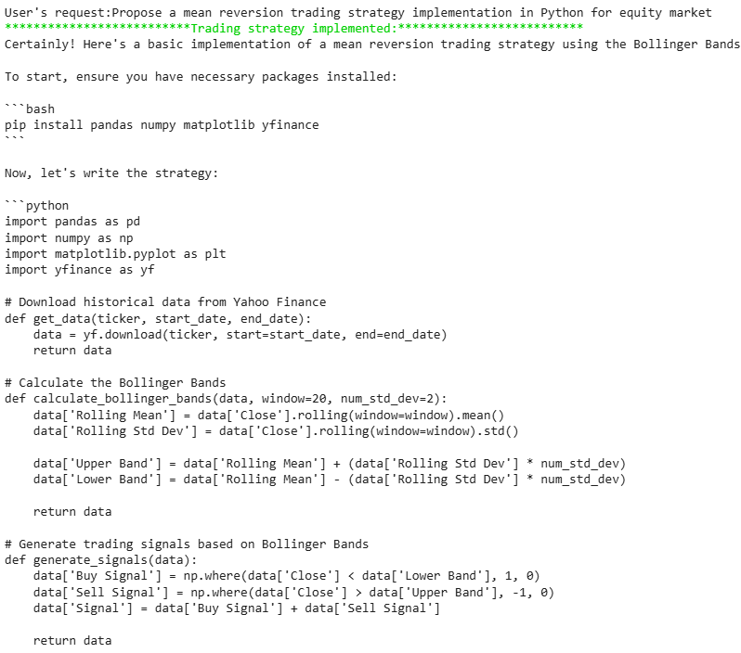
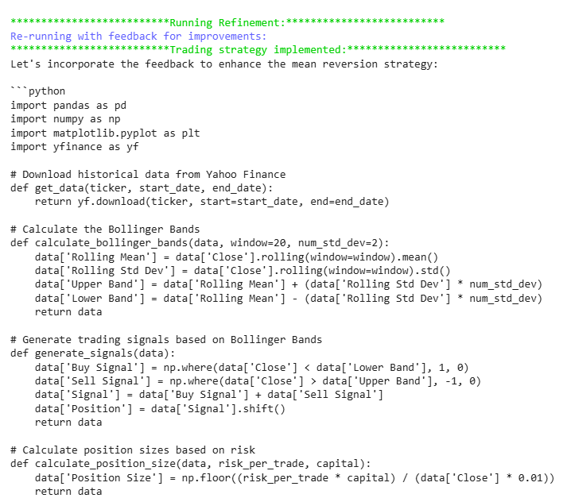
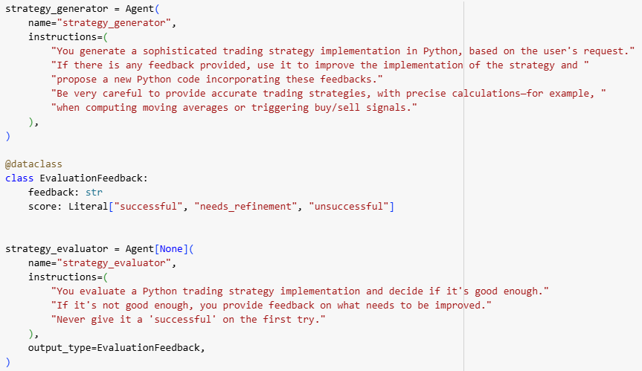
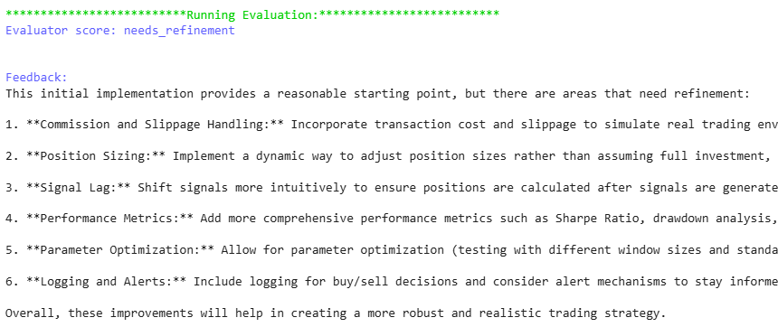
Practical Use Cases in Finance
1- OpenAI Agents SDK - LLM-as-a-Judge
3- Output + feedback ⇒ Refinement
1- Output
2- Feedback
Notebook:
https://drive.google.com/file/d/1B_13aUU71yroGJPkqBFDtT8ipgXUuzXm/view?usp=sharing
>
Pg: 44

Slide 45

Practical Use Cases in Finance
2- Multi-Agent Fundamental Analysis - LLamaIndex
Use case
👉 Build a multi-agent workflow for fundamental analysis
Set up
⚡ We’ll create a multi-agent system composed of:
A fundamental_agent: Responsible for collecting ratios for a given ticker using the FinanceToolkit package
A profitability_agent: Responsible for gathering profitability ratios (ROA, ROE, Net Profit Margin, and Gross Margin) and analyzing their strengths or weaknesses compared to given thresholds. For example, if ROA > 5%, the firm is in a healthy range.
A liquidity_agent: This agent collects liquidity ratios for a given ticker (Current Ratio, Quick Ratio, Debt-to-Equity Ratio, Interest Coverage Ratio) and comments on these ratios given a set of threshold values. For example if Current Ratio is between 1.5-3.0 the firm is in a healthy range.
A supervisor_agent: This agent provides a final comment on the overall health of the firm based on the different comments coming from the different agents.
Multi-Agent Fundamental Analyst
fundamental_agent
profitability_agent
liquidity_agent
supervisor_agent
root agent
get_fundamentals
get_profitability_ratios
get_liquidity_ratios
get_overall_comments
Tools
Shared State
Notebook:
https://drive.google.com/file/d/1hBEmRlAlu5oA-Ksi5x9LE64q6D21ECMP/view?usp=sharing
>
Pg: 45

Slide 46
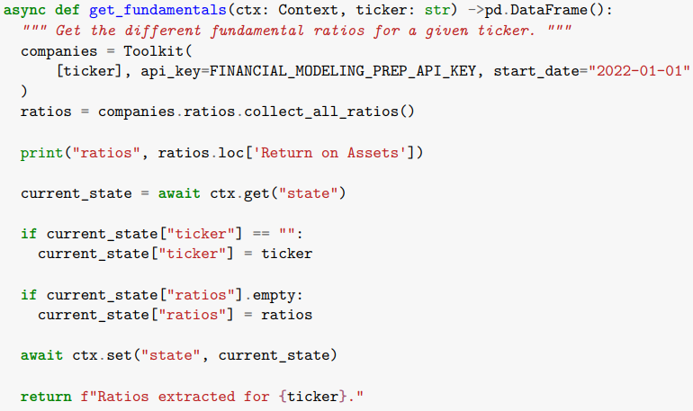
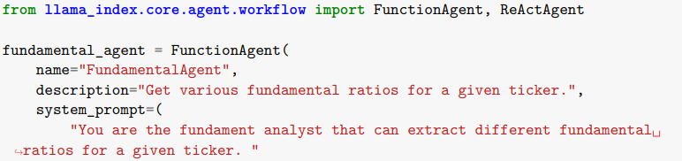
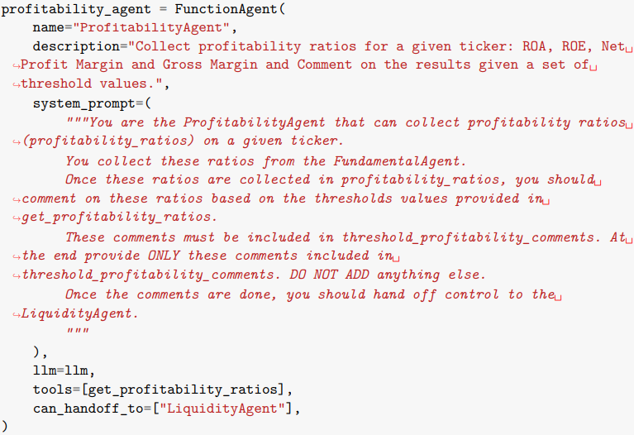
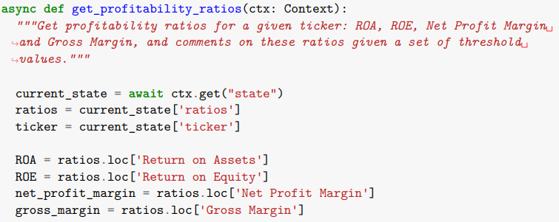
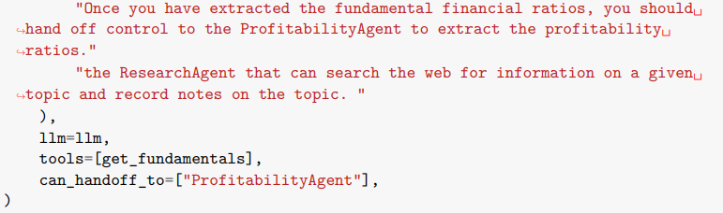
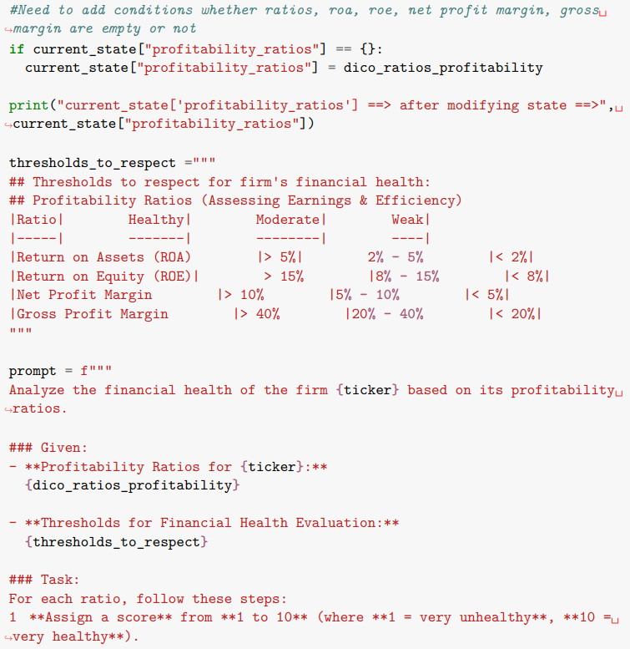
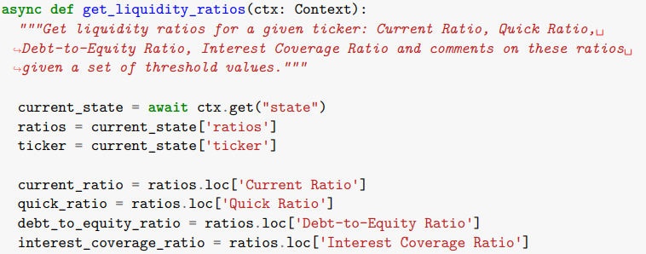
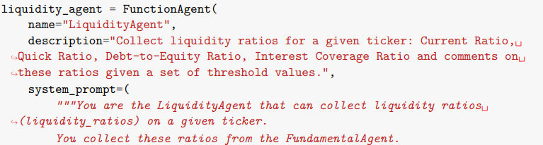
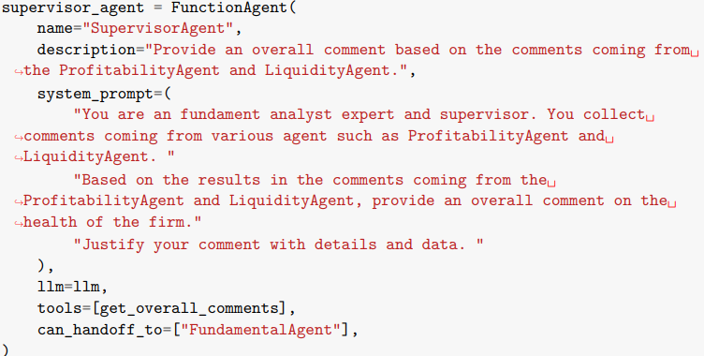
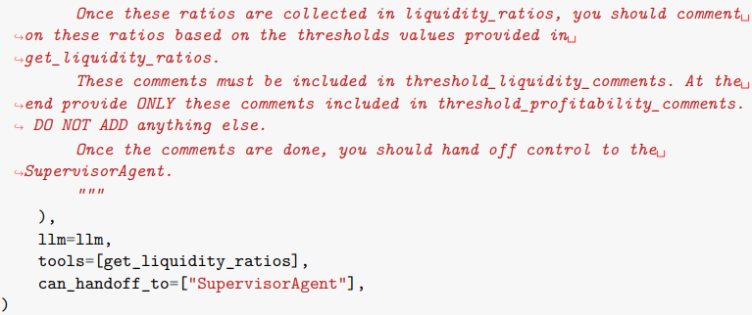
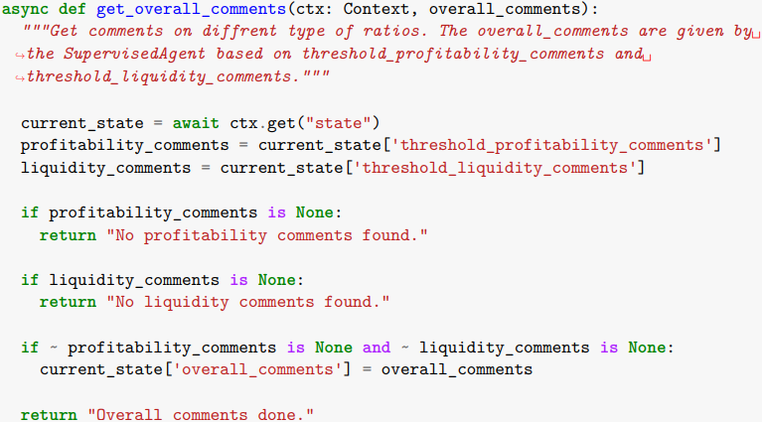
Practical Use Cases in Finance
2- Multi-Agent Fundamental Analysis - LLamaIndex
TOOLS
MULTI-AGENT SYSTEM
1
2
3
4
Notebook:
https://drive.google.com/file/d/1hBEmRlAlu5oA-Ksi5x9LE64q6D21ECMP/view?usp=sharing
>
Pg: 46

Slide 47
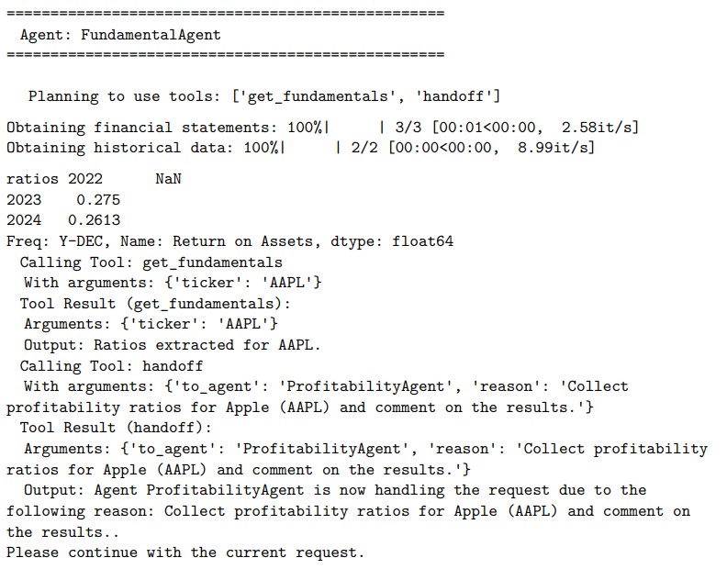
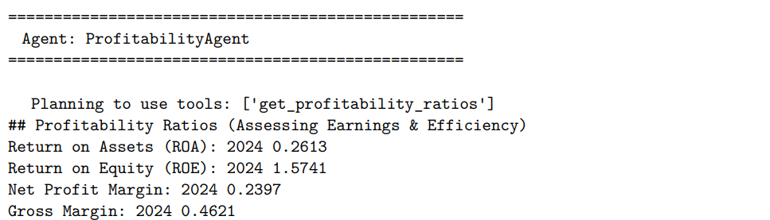
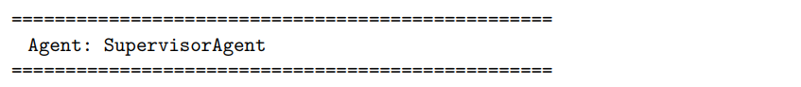
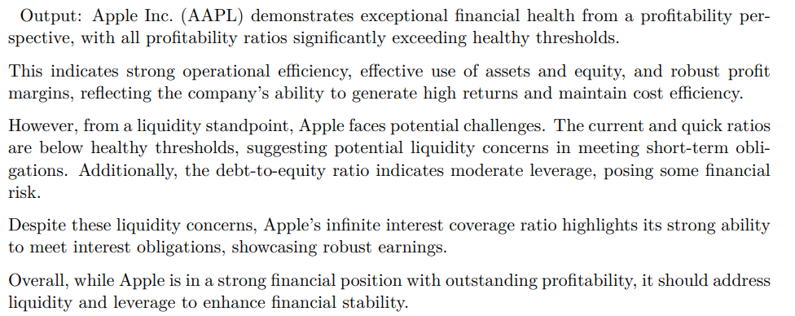
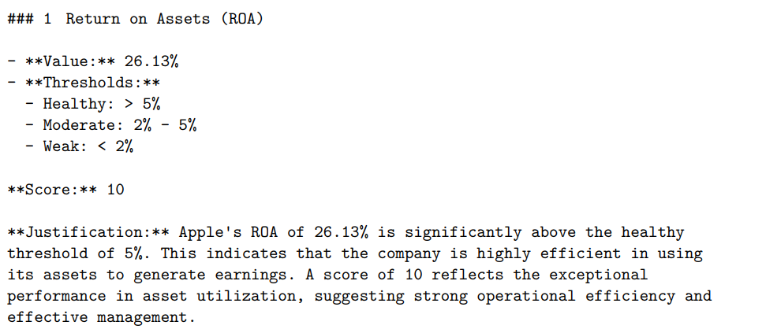
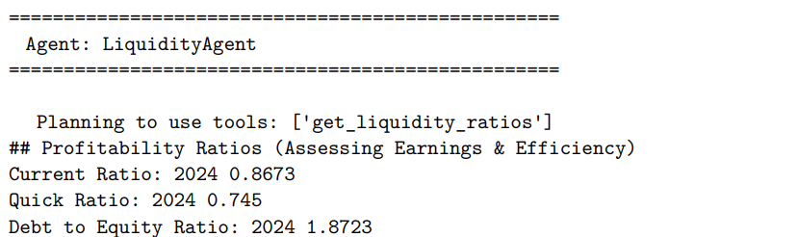
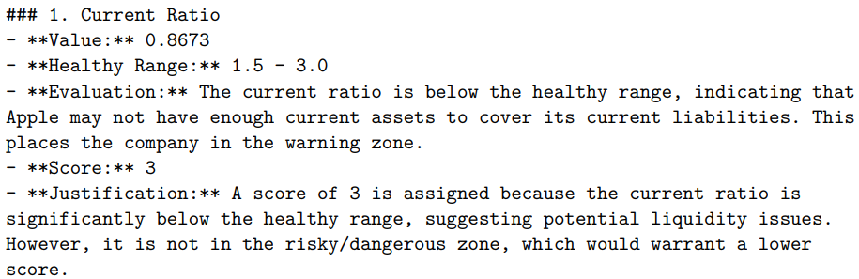
Practical Use Cases in Finance
2- Multi-Agent Fundamental Analysis - LLamaIndex
Notebook:
https://drive.google.com/file/d/1hBEmRlAlu5oA-Ksi5x9LE64q6D21ECMP/view?usp=sharing
>
Pg: 47

Slide 48
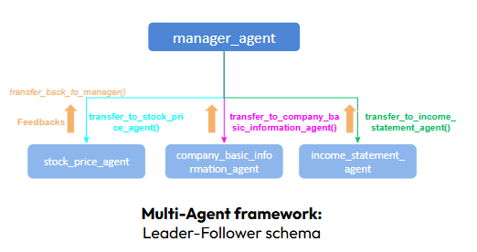

Practical Use Cases in Finance
3- OpenAI Agents SDK - Financial Analysis
Use case
Agents SDK/Swarm: Agentic Financial Analyst
👉 So, How to set up this new agents SDK for financial analysis purpose?
I created 4 agents:
1- manager_agent: This agent will handle determining and switching between agents to transfer the user's request to the best suited agent.
2- stock_price_agent: This agent is responsible of fetching the last available price, volume, average price 50d, 200d, EPS, PE, and the next earnings announcement.
3- company_basic_information_agent: This agent is responsible of collecting the company basic data like description market capitalization, sector, industry…
4- income_statement_agent: This agent is responsible of gathering the last income statement data such as revenue, gross profit, net income, EBITDA, EPS.
PDF:
https://drive.google.com/file/d/1Zf6qQrUOZQIIjc3ABLXacmd4QcEbOoIW/view?usp=sharing
>
Pg: 48

Slide 49
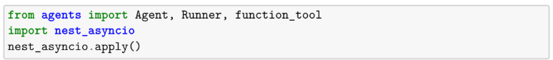
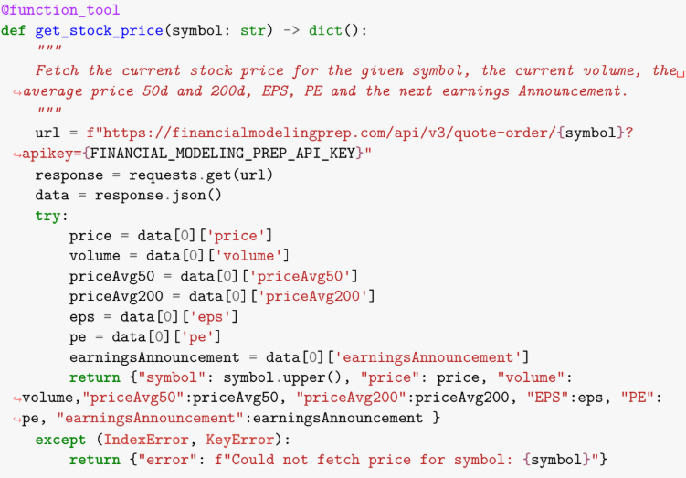







Practical Use Cases in Finance
3- OpenAI Agents SDK - Financial Analysis
Multi-Agent set up
TOOLS
MULTI-AGENT SYSTEM
Manager
PDF:
https://drive.google.com/file/d/1Zf6qQrUOZQIIjc3ABLXacmd4QcEbOoIW/view?usp=sharing
>
Pg: 49

Slide 50





Practical Use Cases in Finance
3- OpenAI Agents SDK - Financial Analysis
Tracing
PDF:
https://drive.google.com/file/d/1Zf6qQrUOZQIIjc3ABLXacmd4QcEbOoIW/view?usp=sharing
>
Pg: 50

Slide 51


Practical Use Cases in Finance
4- ReAct Finance Agent - LlamaIndex
PDF:
https://drive.google.com/file/d/1L4OH45V-hrMX5XHutGmrOOuA6oNg55mG/view?usp=sharing
Notebook: https://drive.google.com/file/d/1QY0EHGBQopT8R4hRmu9hpEZCY81jedlo/view?usp=sharing
Source - Paper: https://arxiv.org/pdf/2210.03629
>
Pg: 51

Slide 52












Practical Use Cases in Finance
4- ReAct Finance Agent - LlamaIndex
Use case
👉 Collect information about stock prices and news for a given stock.
TOOLS
React Agent
PDF:
https://drive.google.com/file/d/1L4OH45V-hrMX5XHutGmrOOuA6oNg55mG/view?usp=sharing
Notebook: https://drive.google.com/file/d/1QY0EHGBQopT8R4hRmu9hpEZCY81jedlo/view?usp=sharing
>
Pg: 52

Slide 53


Practical Use Cases in Finance
5- Reflection Agent - LangChain
PDF:
https://drive.google.com/file/d/1OXyGfoOELUDJxeb6SlWOxr9emoL8WGVo/view?usp=sharing
Notebook: https://drive.google.com/file/d/15ntoBGU0Q2RIcT-fDnU3GYCVBW-zi-4X/view?usp=sharing
Source : LangChain
>
Pg: 53

Slide 54




Practical Use Cases in Finance
5- Reflection Agent - LangChain
Generator
PDF:
https://drive.google.com/file/d/1OXyGfoOELUDJxeb6SlWOxr9emoL8WGVo/view?usp=sharing
Notebook: https://drive.google.com/file/d/15ntoBGU0Q2RIcT-fDnU3GYCVBW-zi-4X/view?usp=sharing
>
Pg: 54

Slide 55



Practical Use Cases in Finance
5- Reflection Agent - LangChain
Generator
Reflection
PDF:
https://drive.google.com/file/d/1OXyGfoOELUDJxeb6SlWOxr9emoL8WGVo/view?usp=sharing
Notebook: https://drive.google.com/file/d/15ntoBGU0Q2RIcT-fDnU3GYCVBW-zi-4X/view?usp=sharing
>
Pg: 55

Slide 56


Practical Use Cases in Finance
5- Reflection Agent - LangChain
Generator
Reflection
Review
…
PDF:
https://drive.google.com/file/d/1OXyGfoOELUDJxeb6SlWOxr9emoL8WGVo/view?usp=sharing
Notebook: https://drive.google.com/file/d/15ntoBGU0Q2RIcT-fDnU3GYCVBW-zi-4X/view?usp=sharing
>
Pg: 56

Slide 57
Section [09]: Key Takeaways

Slide 58
Key Takeaways
👉 AI Agents in Finance
Ideal for tasks such as market analysis, fraud detection, portfolio optimization, and regulatory compliance.
Provide autonomy, interactivity, adaptability, and goal-oriented execution.
👉 Common Patterns & Architectures
Patterns include Deterministic Flows, Parallelization, LLM-as-a-Judge, Guardrails, and Tool Use.
Architectural styles vary (Sequential, Parallel, Orchestrator-Worker, Hierarchical) based on task complexity and communication needs.
👉 When to Use AI Agents
Opt for the simplest solution first; increase complexity only as needed.
Choose agentic systems when flexibility and model-driven decision-making at scale are essential.
Be mindful of cost, latency, and error risks—use agents where the trade-off is justified.
👉 Designing Agentic Workflows
Clearly define tasks, agents’ roles, and communication channels.
Thoughtful tool integration and robust guardrails enhance effectiveness and reliability.
Implement iterative feedback loops (ReAct, Self-Refine, Reflexion) to improve performance continuously.
>
Pg: 58

Slide 59

Further Reading/Learning
Papers
Courses
AutoGen: Enabling Next-Gen LLM Applications via Multi-Agent Conversation: https://arxiv.org/pdf/2308.08155
CRITIC: Large Language Models Can Self-Correct with Tool-Interactive Critiquing: https://arxiv.org/abs/2305.11738
Self-Refine: Iterative Refinement with Self-Feedback: https://arxiv.org/abs/2303.17651
Reflexion: Language Agents with Verbal Reinforcement Learning: https://arxiv.org/abs/2303.11366
CRAG: Corrective Retrieval Augmented Generation: https://arxiv.org/pdf/2401.15884
MemGPT: Towards LLMs as Operating Systems
https://arxiv.org/abs/2310.08560
To learn how to build Agent Workflow - Hands-on in Python:
Free Short Course from deepLearning.ai :
Building Agentic RAG with LlamaIndex
Functions, Tools and Agents with LangChain
AI Agentic Design Patterns with AutoGen
Multi AI Agent Systems with crewAI
HuggingFace Agents course:
https://huggingface.co/learn/agents-course/unit0/introduction
LangGraph Academy:
https://academy.langchain.com/courses/intro-to-langgraph
Different Providers:
Anthropic
OpenAI
Google
>
Pg: 59

Slide 60
Thank You!
Any Questions?

